Slide 1

Soal 1 (SQL)
Fraud Data Analytics Internship
Case Study: Transaksi Judi Online
by Ferdian Razak

Slide 2
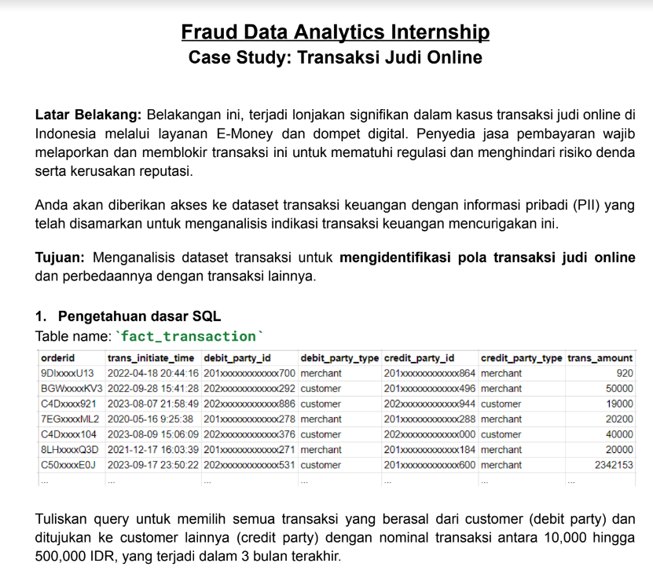
Soal 1

Slide 3
Query Answer
SELECT *
FROM fact_transaction
WHERE trans_initiate_time >= DATE_SUB(CURRENT_DATE, INTERVAL 3 MONTH)
AND debit_party_type = 'customer’
AND credit_party_type = 'customer'
AND trans_amount BETWEEN 10000 AND 500000;

